Slide 1
The Big Beautiful Bill “Just The Facts” as they relate to Medicaid and SNAP
Big Beautiful Bill; HR-1, pp.219-330
Subtitle B-Health
Chapter-1 Medicaid
By: Joe T. Potts, M.S. PT
CEO, Full Life Services, Inc.
joseph@fulllifeservices.org.

Slide 2
How to find and read the Big Beautiful Bill for yourself
Go here: https://www.congress.gov/bill/119th-congress/house-bill/1/text
Download PDF text (869KB), Will be 330 pages long. The page numbers that I reference will be correct on this version of the bill. (see Appendix 2. for specific instructions)
Useful Definitions
CHIP-Children’s Health Insurance Program: Part of Medicaid for children and pregnant women.
SNAP- Supplemental Nutrition Assistance Program: used to be called “food stamps”
Non-expansion state: A state that did not choose to participate in Medicaid expansion under the ACA, like Texas
ACA- Affordable Care Act: An act that established the “Health Insurance Markets” and offered states the chance to expand Medicaid coverage to the poor with the federal government paying about 90% of the cost. Under the Big Beautiful Bill these people on Medicaid will face work/volunteer requirement, and stricter requalification every 6 months.
FMAP- Federal Medical Assistance Percentage: the percentage the federal government pays the states for the cost they pay out for Medicaid and CHIPS

Slide 3
What to consider when looking at the Big Beautiful Bill
This bill is for the next 10 years.
This bill was written and voted into law very rapidly so some items may prove to be impractical and may have to be corrected.
Nothing much will happen to people in Texas on Medicaid or CHIP until 2026 and some not until 2029
Texas is not a “Medicaid expansion state” and several provisions in the bill do not apply to us.
Much of the bill is targeted at Planned Parenthood type organizations, undocumented immigrants, people on “Medicaid expansion plans”, people in nursing homes who own expensive homes and people exposed to radiation

Slide 4
So, Lets Get started on the Big Beautiful Bill
I will discuss the topics in the order they are presented in the bill.
We only have an hour so I will skip over some details and areas unrelated to Medicaid, CHIPS or Medicare.
Please save questions until the end as I want to cover the areas of importance.
This bill is highly controversial with much speculation about how it will affect people on Medicaid and CHIPS. This is a presentation on what the text says in this bill. I have referenced the exact location in the bill of the areas of discussion, so you can come to your own conclusions as to the likely results of this bill.

Slide 5
The Big Beautiful Bill Puts Older Federal Laws On Hold.
The Big Beautiful Bill tells the Secretary of Health and Human Services to ignore (for 10 years) these federal laws below:
“Streamlining Medicaid Medicare Savings Program Eligibility Determination Enrollment’’ (88 Fed. Reg. 65230) (pp.219, sec.71101)
‘‘Medicaid Program; “Streamlining the Medicaid, Children’s Health Insurance Program, and Basic Health Program Application, Eligibility Determination, Enrollment renewal Processes’’ (89 Fed. Reg. 22780)(pp. 219sec. 71102)
‘‘Medicare and Medicaid Programs; Minimum Staffing Standards for Long-Term Care Facilities and Medicaid Institutional Payment Transparency Reporting’’ (89 Fed Reg. 40876) (pp. 227,sec. 71111)

Slide 6
Require States to add measures to Reduce waste and fraud
Reduce Duplicate enrolment: Instructs the Secretary to build a systems to cross check for multi state enrollment in Medicaid or CHIP, mainly using Social Security Number. The program will start in 2027 and be fully functional by 2029. The system is to be checked every month for dual enrolments in Medicaid or CHIP. (Sec. 71103, pp 220)
Mandates states to check the Social Security Death Master File every 3 months for any active receipants of Medicaid or CHIP.: If some one is found on the file they will be immediately dropped for Medicaid or CHI.P This file also use your Social Security Number. (Sec. 71104-71105 pp. 222-223)
So, what does the mean for our kids:
There is always a chance for error and mistakes. Also, many people have had their Social Security number hacked. You cannot do much about the hacking, but you can be sure you have your child’s Social Security card handy as well as a state, photo ID to quickly clear up any errors.

Slide 7
Requalification for Medicaid for our kids does not change.
The bill Increases Medicaid requalification to every 6 months is for Individuals enrolled under subsection (a)(10)(A)(i)(VIII).
This measure caused some anxiety among IDD advocates until the above, underlined string of letters and numbers was analyzed. This refers to people enrolled in the “Medicaid expansion plan” as we spoke of before. As I said before Texas is not a Medicaid expansion state, so our kid’s Medicaid or CHIP requalification should not be affected. (Sec. 71107, pp.224)

Slide 8
The Bill Restricts Medicaid Eligibility for Certain Non-Citizens and Undocumented Immigrants
Restricts Medicaid and Chip enrollment to; a citizen or national of the United States; an alien lawfully admitted for permanent residence as an immigrant. (Sec. 17709, pp. 226)
Expands FMAP for emergencies service for undocumented immigrants. They realized more uninsured people will go to the emergency room and this should help out the hospitals. (Sec. 17710, pp. 227)
The Supreme Court did not strike down birthright citizenship but just stated that lower courts cannot make broad, sweeping rulings. Birthright citizens right to Medicaid or CHIP will likely be on a case by case basis.

Slide 9
Preventing Wasteful Spending in Medicaid
Medicaid and CHIP has been covering Medicaid and CHIP services that were provide up to 3 months before the eligible person is enrolled in Medicaid or CHIP. Now, under this bill that 3 months has been decreased to 2 months. (Sec. 71112, pp. 227)
This means as soon as you start any medical treatment apply for Medicaid. You can start here: https://yourtexasbenefits.com/Learn/Home

Slide 10
This Bill Limits and Cuts Medicaid Provider Taxes
So, what are Medicaid Provider taxes? It is easier to say what they do than understand how they do it. (I have attached a Chat GBT explanation in the appendices if you care to enlighten your self) .
What they do is allow states to receive about 5% more federal funds for Medicaid and CHIP, above their normal FMAP.
This bill freezes “non-expansion states” Medicaid provider taxes at their present level of about 6% and cuts the “expansion states” down by .5% every year starting in 2028 until they reach 3.5% (Sec.71115, pp. 2030-231)

Slide 11
Protecting Rural Hospitals From The Effect of This Bill
Rural Hospital are likely to see more uninsured in their emergency rooms and they are less able than urban hospitals to absorb this increase in uncompensated care.
This bill establishes a 50-million-dollar fund to help rural hospitals. (Sect71401, pp. 256)

Slide 12
Providing Permanent Tax Relief For Middle-Class Families And Workers
Extension and enhancement of increased standard deduction. (SEC. 70102, pp.330)
Sec. 70104. Extension and enhancement of increased child tax credit. (Sec. 70104, pp.330) $2000-$2200
Sec. 70105. Extension and enhancement of deduction for qualified business income.
Sec. 70106. Extension and enhancement of increased estate and gift tax exemption
amounts.
Sec. 70107. Extension of increased alternative minimum tax exemption amounts
and modification of phaseout thresholds.
Sec. 70108. Extension and modification of limitation on deduction for qualified residence
interest.
Sec. 70109. Extension and modification of limitation on casualty loss deduction.
Get stories like this delivered straight to your inbox. Sign up for The 74 Newsletter
For the first time, children and at least one of their parents or guardians will have to have a Social Security number to be able to qualify for the child tax credit. That means an estimated 2.7 million American kids who likely qualify for the credit this year will no longer be able to get it as of next year.

Slide 13
MODIFICATIONS TO SNAP WORK REQUIREMENTS, Qualification for, and State Share of Cost
Snap now requires the able-bodied to work between ages of 18-65 up from 18-55 before the bill. The bill decreases the number of exemptions from the work requirement. (Sec. 10102, pp.10)
The bill makes qualification harder by disallowing certain expenses, like utility cost, and certain internet fees (Sec. 10103, pp.12)
The Big Beautiful Bill increases the states share of the cost of the program. (Sec.10105, pp.12)
The bill does not have provision to exempt parents with disabled kids from the work requirement. This will have to be addressed

Slide 14
Appendix 1.
Explanation of Medicaid Provider Taxes by :Chat GBT
Key Points about Medicaid Provider Taxes:
Purpose:
The main goal of these taxes is to generate additional state revenue that can be used to match federal funding for Medicaid. The federal government typically covers a large portion of Medicaid costs (e.g., 50–80%, depending on the state), and state taxes on providers help them meet their portion of the funding.
Who is Affected:
Healthcare providers that serve Medicaid patients are subject to these taxes. This includes hospitals, nursing homes, intermediate care facilities, home health agencies, and sometimes even certain individual healthcare practitioners.
Tax Rate and Structure:
The rate and structure of Medicaid provider taxes vary by state. Some states impose a flat percentage tax on provider revenue, while others might tax based on other metrics (e.g., the number of Medicaid patients served).

Slide 15
Appendix 1. pp.2
Federal Matching:
One important feature of Medicaid provider taxes is that the federal government matches the amount of revenue a state collects from these taxes, as long as the tax meets certain federal guidelines. This allows states to increase the overall funding for Medicaid services without raising state-level general taxes.
Regulations:
The federal government has strict rules about Medicaid provider taxes. For example, the tax can't be "disproportionately" high for smaller providers, and the state must ensure that the tax doesn’t result in the providers receiving more money back than they paid in taxes. This is to avoid “backdoor” funding mechanisms that could artificially inflate Medicaid revenue.
Use of Funds:
Revenue generated from these taxes is used to help fund the state’s Medicaid program, which covers a wide range of services such as hospital visits, doctor appointments, prescription drugs, long-term care, and more.

Slide 16
Appendix 1. pp.3
Example: Let's say a state imposes a 5% Medicaid provider tax on hospital revenue. If a hospital generates $10 million in Medicaid-related revenue, it would pay $500,000 in Medicaid provider taxes. The state can then use that revenue, along with federal matching funds, to cover the state’s share of Medicaid costs.
Controversy: Some providers argue that Medicaid provider taxes can be burdensome, especially for smaller healthcare businesses that may struggle with cash flow. Others argue that these taxes are a necessary part of financing Medicaid in a sustainable way.

Slide 17
Medicare Changes
Undocumented immigrants are disallowed from getting Medicare. (Sec. 71202, pp.248)
Expanding and clarifying the exclusion for orphan drugs under the drug price negotiation program. Pulls more drugs off the “drug orphan “ program to allow the price to rise. (Sec 71202, pp.249)
Health tax, income tax credits are forbidden to undocumented immigrants. (Sec. 71301, pp.250)
Disallows ‘Premium Tax credits if person is disqualified from Medicaid due to immigrant status. (Sec.71302, pp.251)

Slide 18
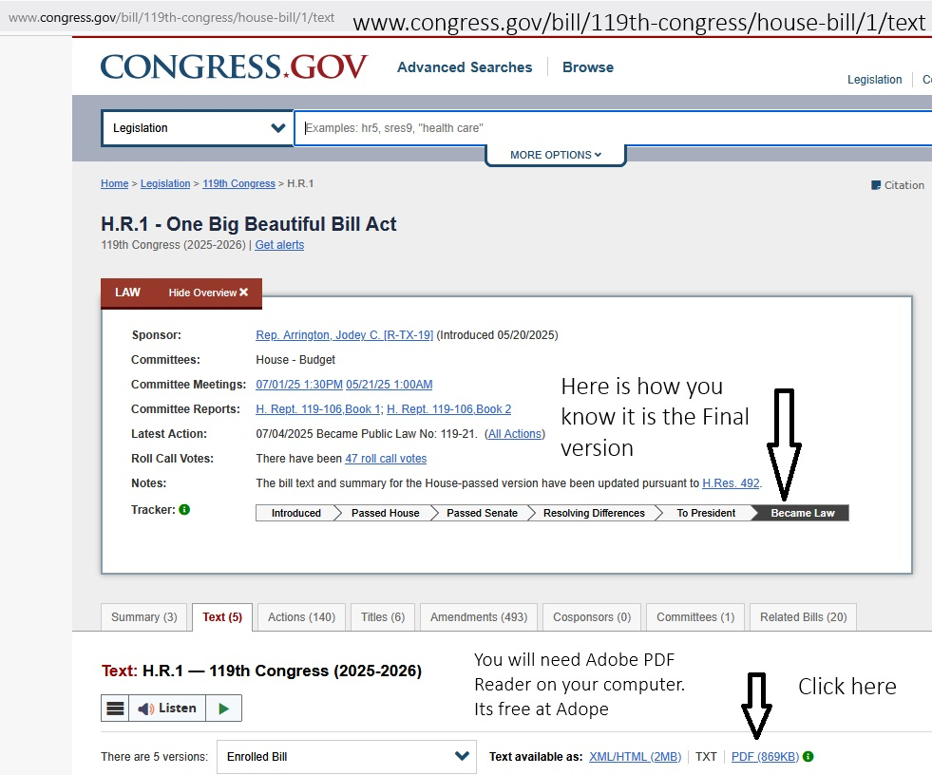
Appendix 2.
How to find the Big Beautiful Bill Text

Slide 19
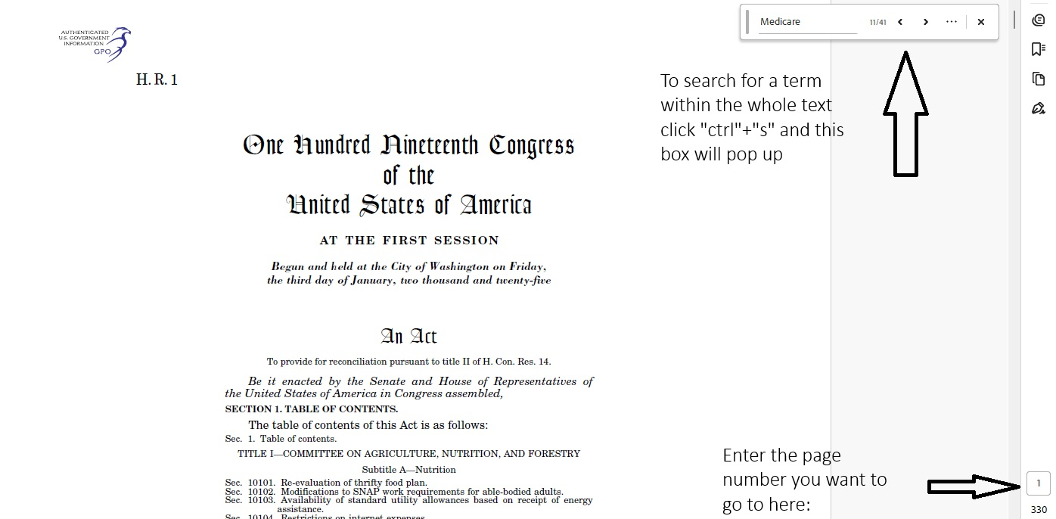
Searching the Big Beautiful Bill
The PDF bill text will look like this:

Slide 20
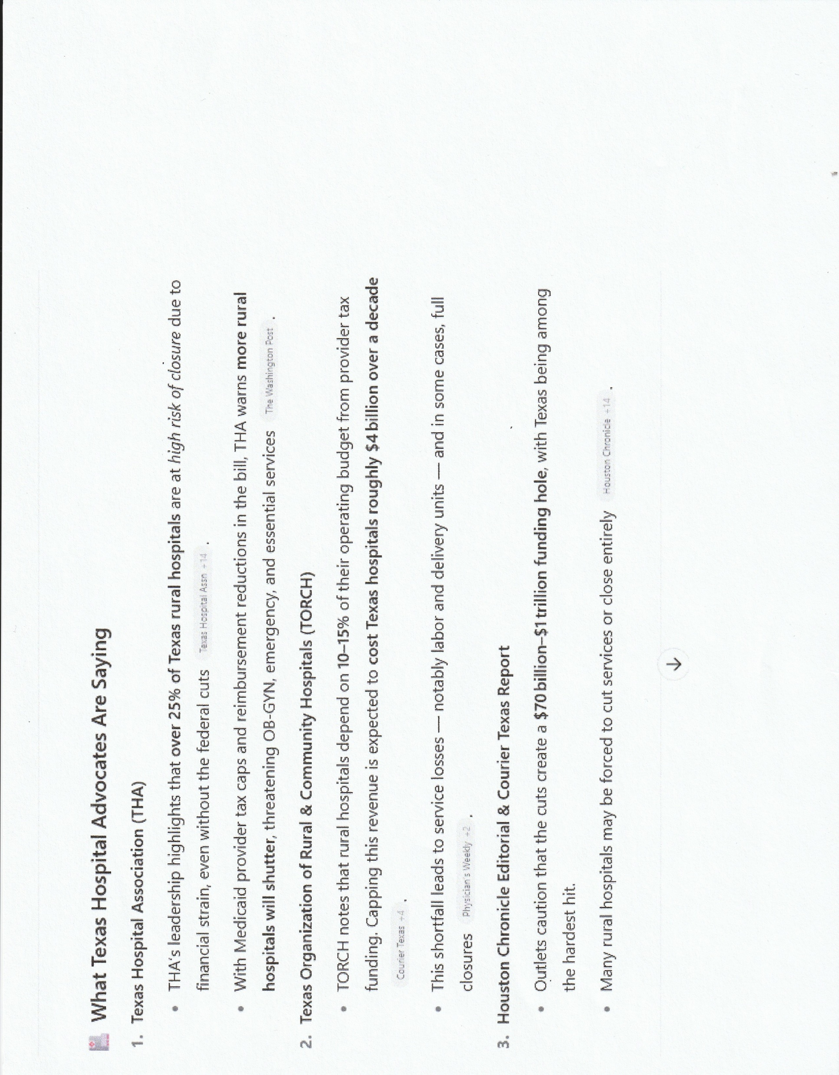
Appendix 3.
What Texas Hospitals say about the Big Beautiful

Slide 21
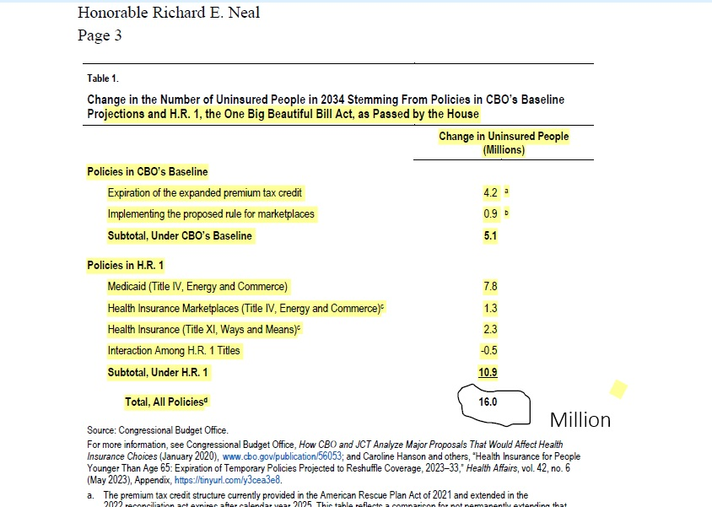
What the Congressional Budget Office say about the Big Beautiful Bill

Slide 22
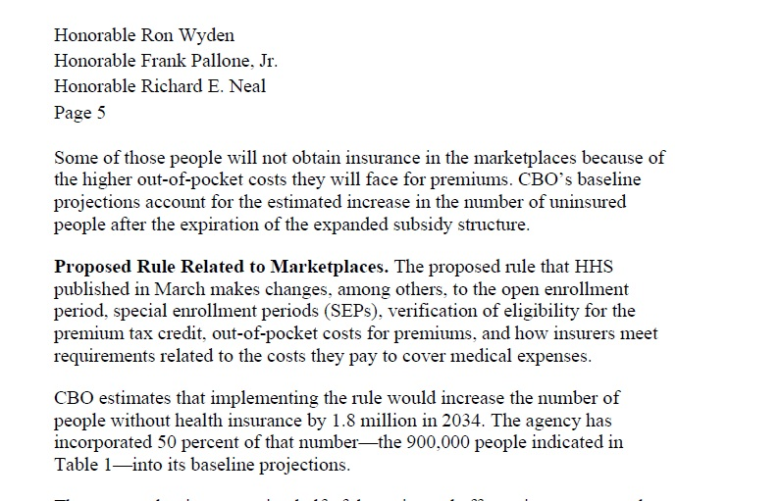
CBO Report of Insurance Loss in “Insurance Market Place” due To the big Beautiful Bill

